Slide 1



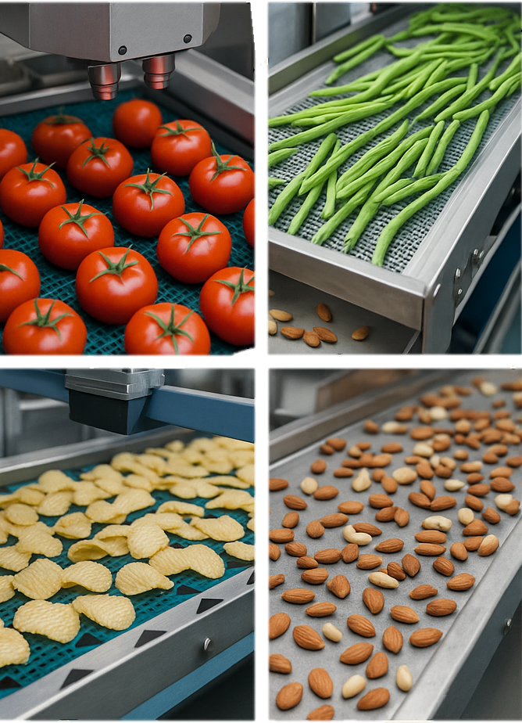
Food Sorting in Food Processing using Shape Application

Slide 2

Team Members
URK22RA1009 Adithya S
URK22RA1010 Krishnasamy P
URK22RA2022 Aashiq Ahmed
URK22RA2011 Aswin P A
01

Slide 3
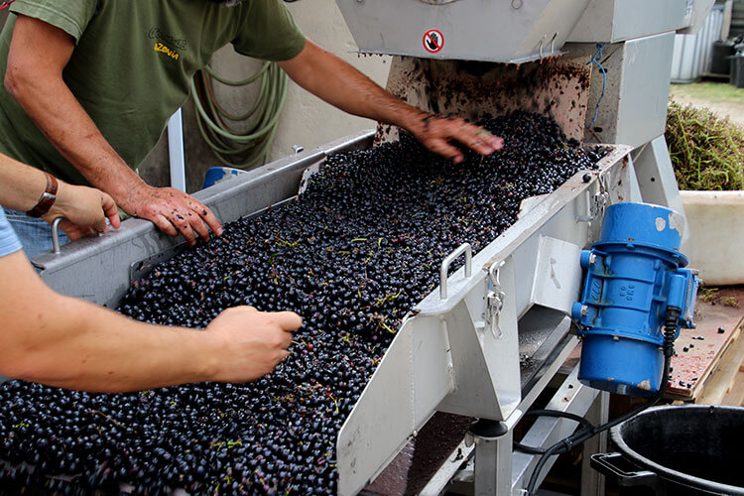
Introduction to Food Sorting
Food sorting is an essential process in food manufacturing and packaging.
It ensures quality control by separating acceptable products from defective ones.
Traditional sorting is manual, which is slow and error-prone.
Automation using computer vision and shape detection helps industries:
Improve efficiency
Reduce human labor
Maintain consistent quality
02

Slide 4
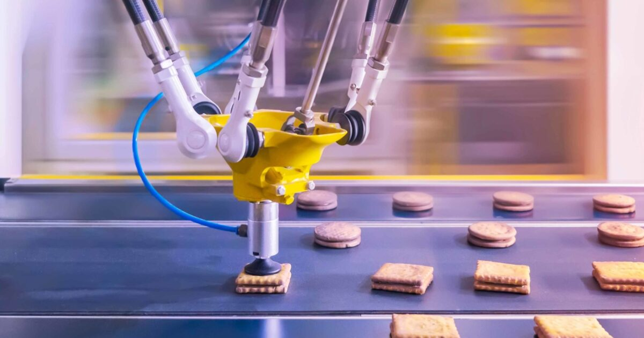
Objective of the Project
To design and develop an automated food sorting system based on shape analysis.
To detect and classify food items using computer vision techniques.
To improve accuracy, speed, and consistency in the sorting process.
To minimize manual labor and human error in food processing industries.
03

Slide 5
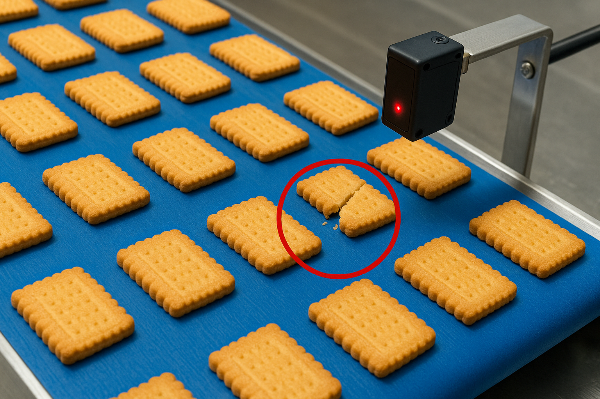
Importance of Food Sorting
Ensures uniformity and product quality.
Removes defective or contaminated items before packaging.
Reduces waste and reprocessing time.
Improves production speed and efficiency.
Enhances consumer satisfaction by maintaining brand consistency.
Critical for food safety compliance and export standards.
04

Slide 6
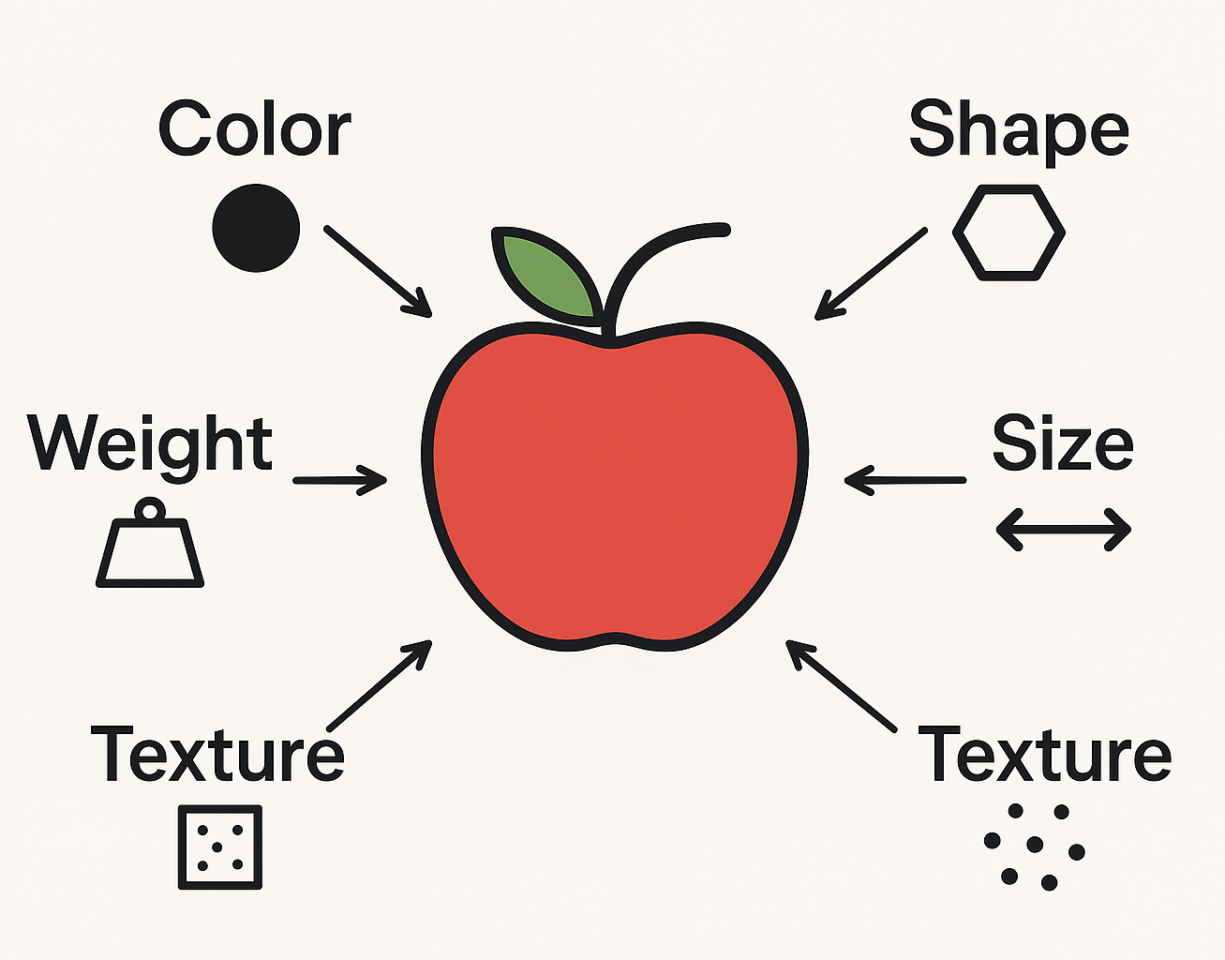
Sorting Parameters in Food Processing
Shape – roundness, aspect ratio, or contour pattern.
Color – ripeness, discoloration, or defects.
Size / Volume – diameter, length, or surface area.
Weight – grading fruits or vegetables by mass.
Texture – surface irregularities, bruises, or cracks.
Defect Detection – broken or misshapen items.
05

Slide 7
Shape Parameter and Algorithm Used
Why Shape?
Used to identify and classify food items based on edges and outlines.
Helps detect defective, broken, or irregular shapes.
Important for sorting items like biscuits, chips, and fruits.
Features Used:
Area: Total pixels enclosed by detected edges.
Perimeter: Length of the object’s outline (from contour).
Aspect Ratio: Width ÷ height of the bounding box.
Circularity – 4*𝜋×(Area / Perimeter ^ 2)
06

Slide 8
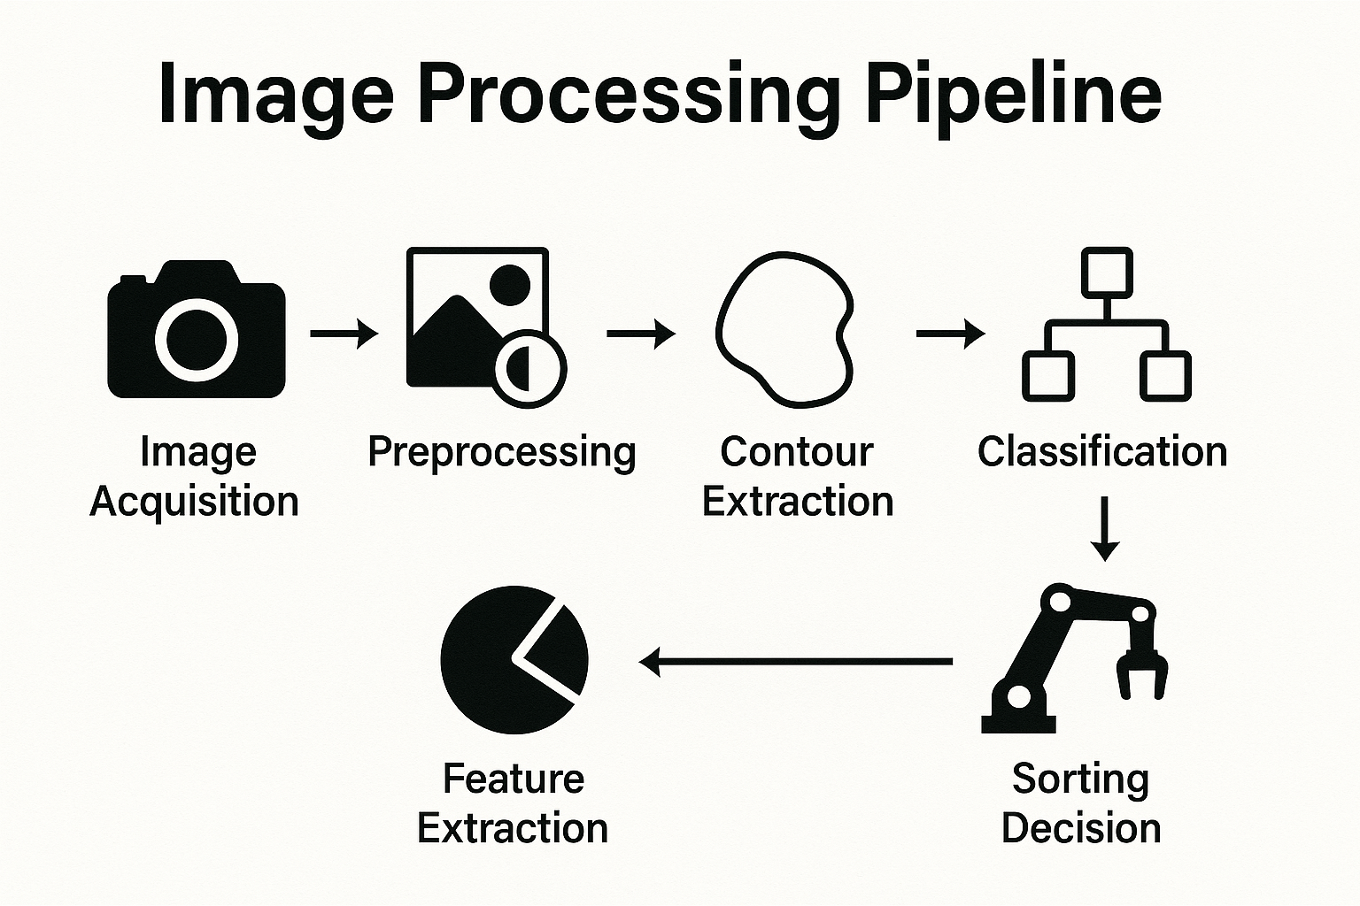
Shape Parameter and Algorithm Used
Tools / Libraries:
Python + OpenCV (for image processing)
Raspberry Pi 5 (for real-time processing)
Steps
in
Algorithm
07

Slide 9
Edge Detection for Shape Recognition
Algorithm Used: Canny Edge Detection (OpenCV)
Steps Involved:
Image Acquisition – Capture image using camera.
Grayscale Conversion – Convert to a single intensity channel.
Noise Reduction – Apply Gaussian Blur to smooth image.
Gradient Calculation – Detect intensity change using Sobel filters.
Non-Maximum Suppression – Keep only the strongest edges.
Double Thresholding – Identify strong and weak edges.
Edge Tracking by Hysteresis – Connect valid edge pixels.
08
Output: A clear binary edge map outlining each object’s shape.

Slide 10
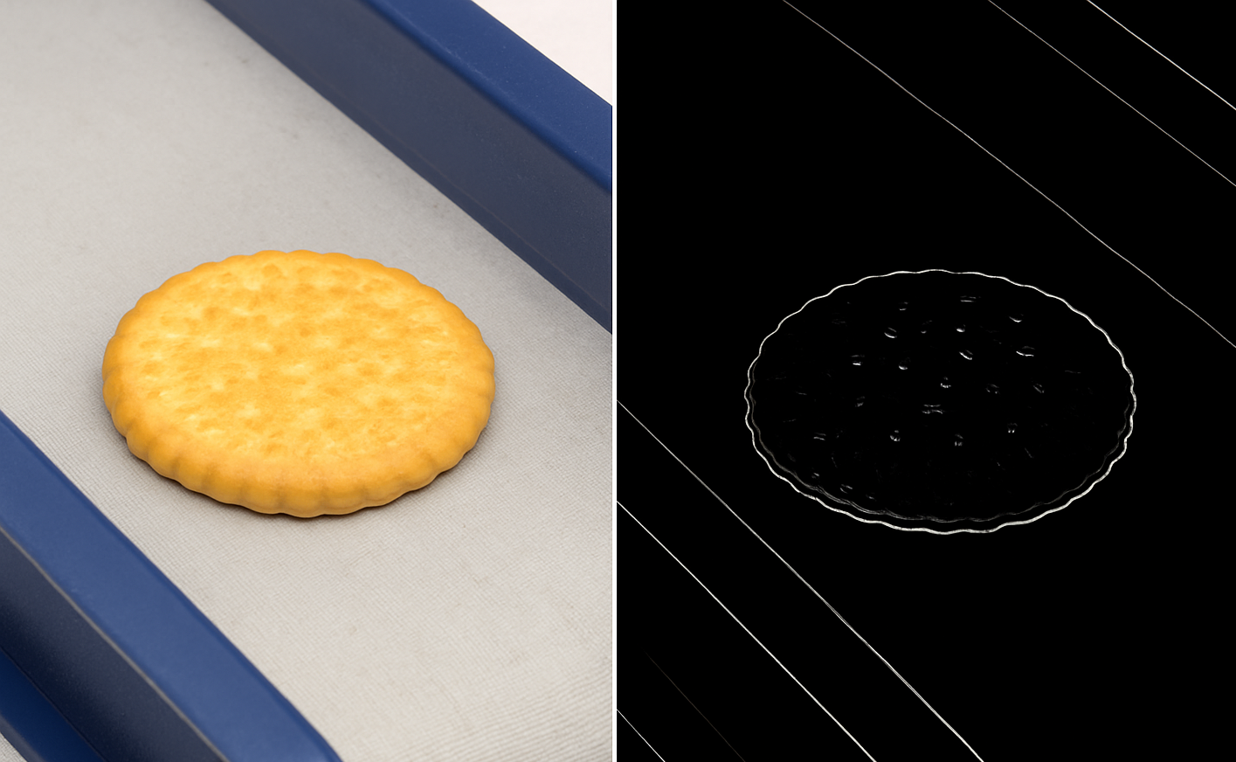
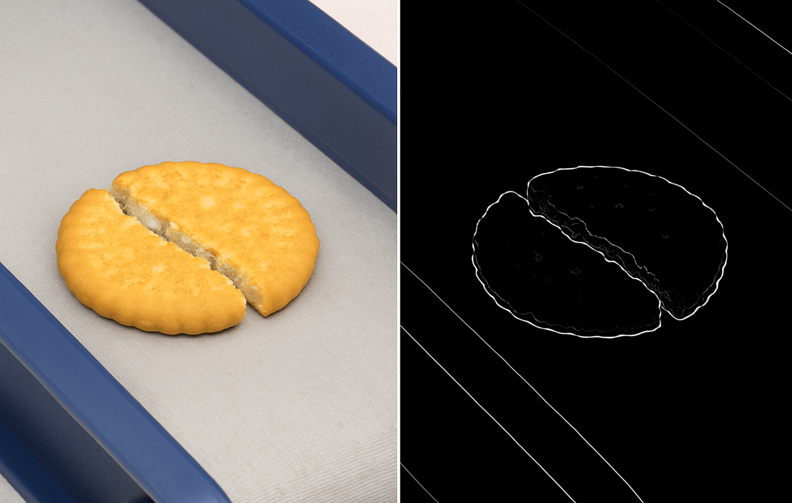
Edge Detection for Shape Recognition
09

Slide 11
Components Used
Raspberry Pi 5
Main controller and processor
Runs image processing using OpenCV
Controls motor and camera modules
Conveyor Belt (DC Geared Motor)
Moves food items for inspection
Geared motor ensures steady motion
Adjustable speed for smooth sorting
Camera Module
Captures top-view images of food
High-resolution for accurate detection
Connected to Pi via CSI/USB
10

Slide 12
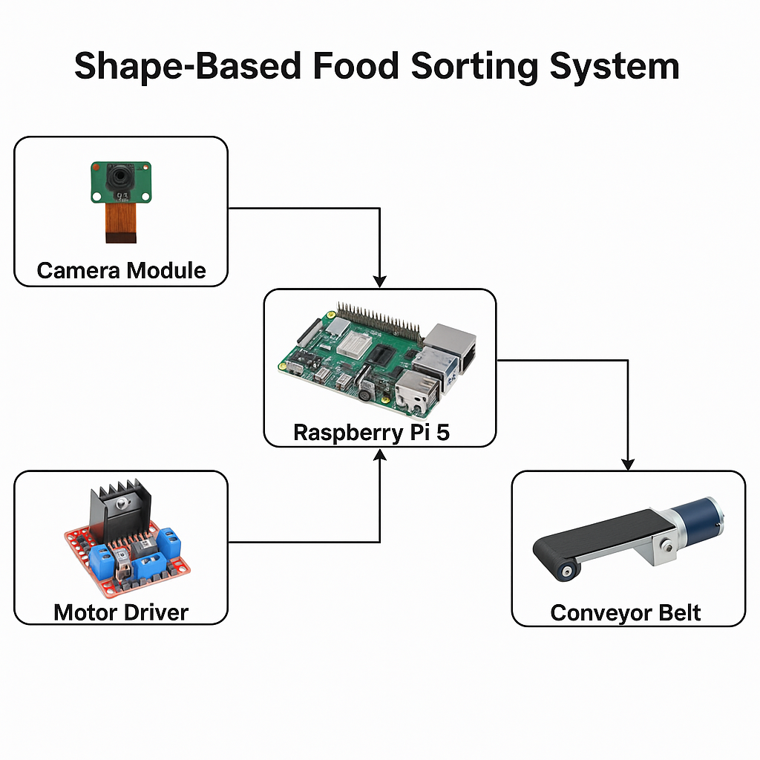
Block Diagram
11

Slide 13
Results and Output
Detection Output
System successfully identifies edges and contours of food items.
Differentiates between normal and broken/deformed biscuits.
Calculates shape parameters in real time.
Sorting Action
Raspberry Pi triggers motor/servo when a defective item is detected.
Good items move forward; defective ones are diverted automatically.
12

Slide 14
Performance Analysis
Parameter | Achieved Value | Remarks
Detection Accuracy | 93–95% | Depends on lighting & camera clarity
Processing Speed | ~2.5 frames/sec | Real-time performance on Raspberry Pi 5
Sorting Accuracy | ~90% | Effective under stable conveyor speed
Power Consumption | Low | Efficient operation with DC motors
Observations:
Better edge detection in uniform lighting.
Broken edges and irregular contours correctly classified.
Minor errors occur with blurred images or overlapping biscuits.
13

Slide 15
Advantages
High accuracy in detecting shape defects.
Automated process reduces manual labor.
Works in real time on conveyor setup.
Low-cost system using Raspberry Pi and OpenCV.
Non-contact and hygienic sorting process.
14

Slide 16

Limitations
Accuracy depends on lighting and camera angle.
Difficult to handle overlapping or touching items.
Sensitive to motion blur at higher conveyor speeds.
Limited to shape-based detection (no color or texture filtering yet).
15

Slide 17
Future Scope
Integrate color and size-based sorting.
Add AI / Deep Learning for better defect classification.
Combine with IoT for real-time monitoring and analytics.
Scale for industrial food lines with multiple cameras.
16

Slide 18
CONCLUSION
Developed an automated food sorting system based on shape detection.
Implemented edge detection (Canny) using OpenCV and Raspberry Pi 5.
Successfully identified broken or irregular biscuits on a moving conveyor.
Achieved high accuracy with real-time processing capability.
System reduces manual effort and improves sorting efficiency.
Can be enhanced with AI and multi-parameter sorting in the future.
17

Slide 19
THANK YOU
18

